Slide 1
Analyzing A Single-Cell Analysis (Annotation to Biological Interpretation)
Ardo Sanjaya, MD., PhD

Slide 2
Cell Annotations
Each cluster must be assigned a biological identity (e.g., hepatocytes, Kupffer cells).
Automatic
Manual

Slide 3
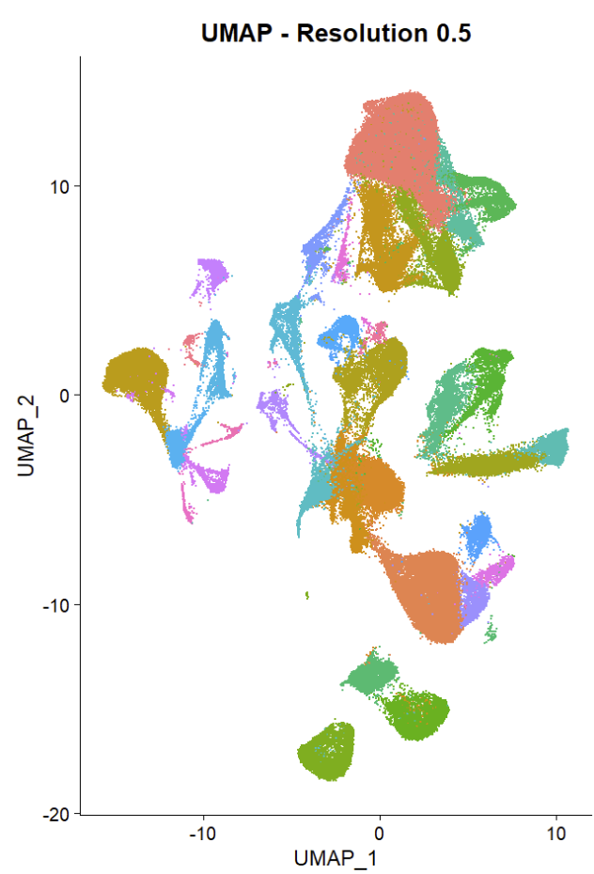
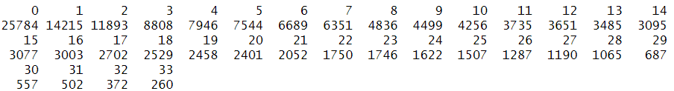
Cells Identified with Resolutions 0.5

Slide 4
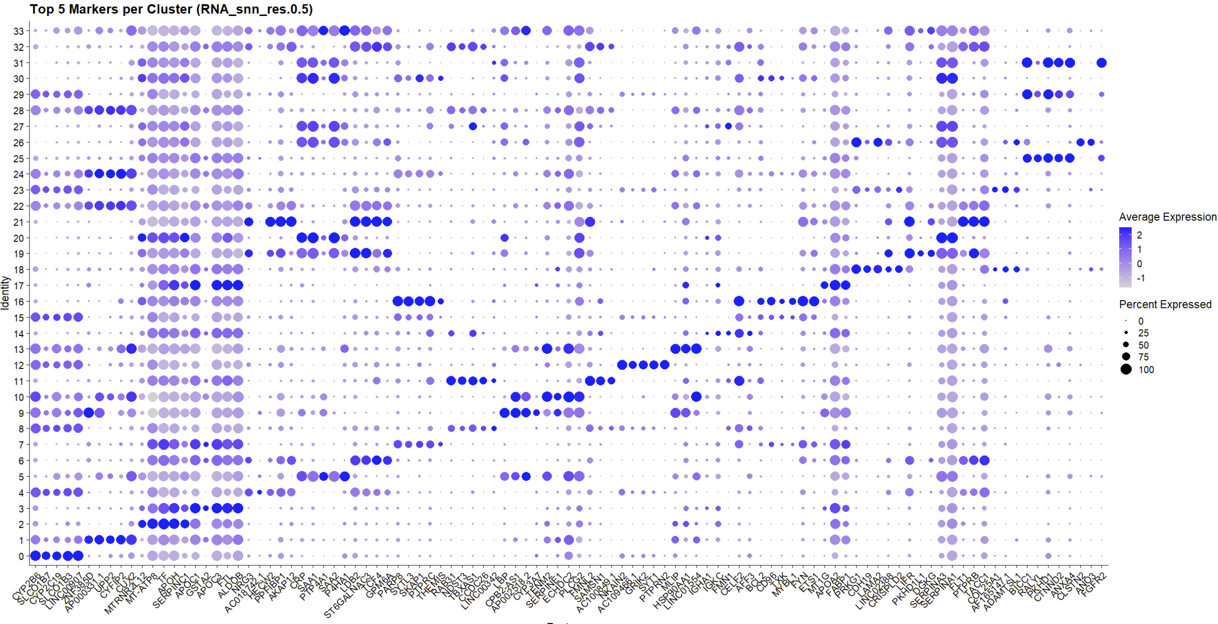

Slide 5
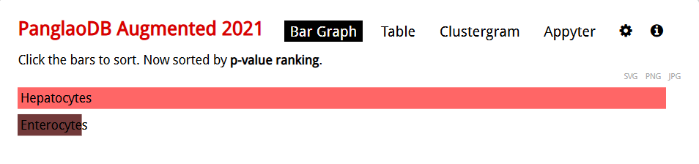
Enrichment Results (Repeat for Every Clusters)

Slide 6
Differential Expression Analysis
Compares expression levels of genes between two groups of cells
Identifies disease-associated genes to reveal biological processes.

Slide 7
Example DE Analysis on Hepatocytes
 | p_val | avg_log2FC | pct.1 | pct.2 | p_val_adj | gene
ANKRD1 | 9.89E-16 | -6.45929 | 0.667 | 1 | 3.22E-11 | ANKRD1
NRG2 | 2.37E-11 | -3.47045 | 1 | 1 | 7.70E-07 | NRG2
KRT23 | 6.87E-11 | -6.32266 | 0.667 | 1 | 2.23E-06 | KRT23
AL353740.1 | 1.05E-10 | -4.76473 | 0.833 | 1 | 3.43E-06 | AL353740.1
LOXL4 | 8.88E-10 | -4.09428 | 1 | 1 | 2.89E-05 | LOXL4
KRTAP5-AS1 | 1.22E-09 | -3.25697 | 1 | 1 | 3.98E-05 | KRTAP5-AS1
CYTOR | 1.33E-09 | -2.79389 | 1 | 1 | 4.33E-05 | CYTOR
EGOT | 4.20E-09 | -2.7223 | 0.833 | 1 | 0.000137 | EGOT
DUSP8 | 4.71E-09 | -2.41917 | 1 | 1 | 0.000153 | DUSP8
DTNA | 5.76E-09 | -2.998 | 1 | 1 | 0.000187 | DTNA
FAM83F | 1.40E-08 | -2.16906 | 1 | 1 | 0.000454 | FAM83F
LRRC1 | 1.58E-08 | -2.30625 | 1 | 1 | 0.000512 | LRRC1
MIR4435-2HG | 2.06E-08 | -2.16173 | 1 | 1 | 0.000669 | MIR4435-2HG
DCDC2 | 2.21E-08 | -3.20983 | 1 | 1 | 0.000718 | DCDC2
EVC | 3.69E-08 | -2.32168 | 1 | 1 | 0.0012 | EVC

Slide 10
Cell–Cell Communication (CellChat)
Cells communicate via ligand–receptor interactions
CellChat predicts which clusters are “talking” to each other and what signaling pathways are involved.
Visualization of signaling pathways

Slide 12
Interaction Heatmaps

Slide 13
Bubble Plot of Communication Probabilities

Slide 14
Copy Number Variation Analysis
Cancer cells often have chromosomal gains/losses visible as copy number changes.
inferCNV uses scRNA-seq expression to infer large-scale genomic alterations at the single-cell level. This helps distinguish malignant vs. normal cells or spot abnormal subclones.

Slide 15
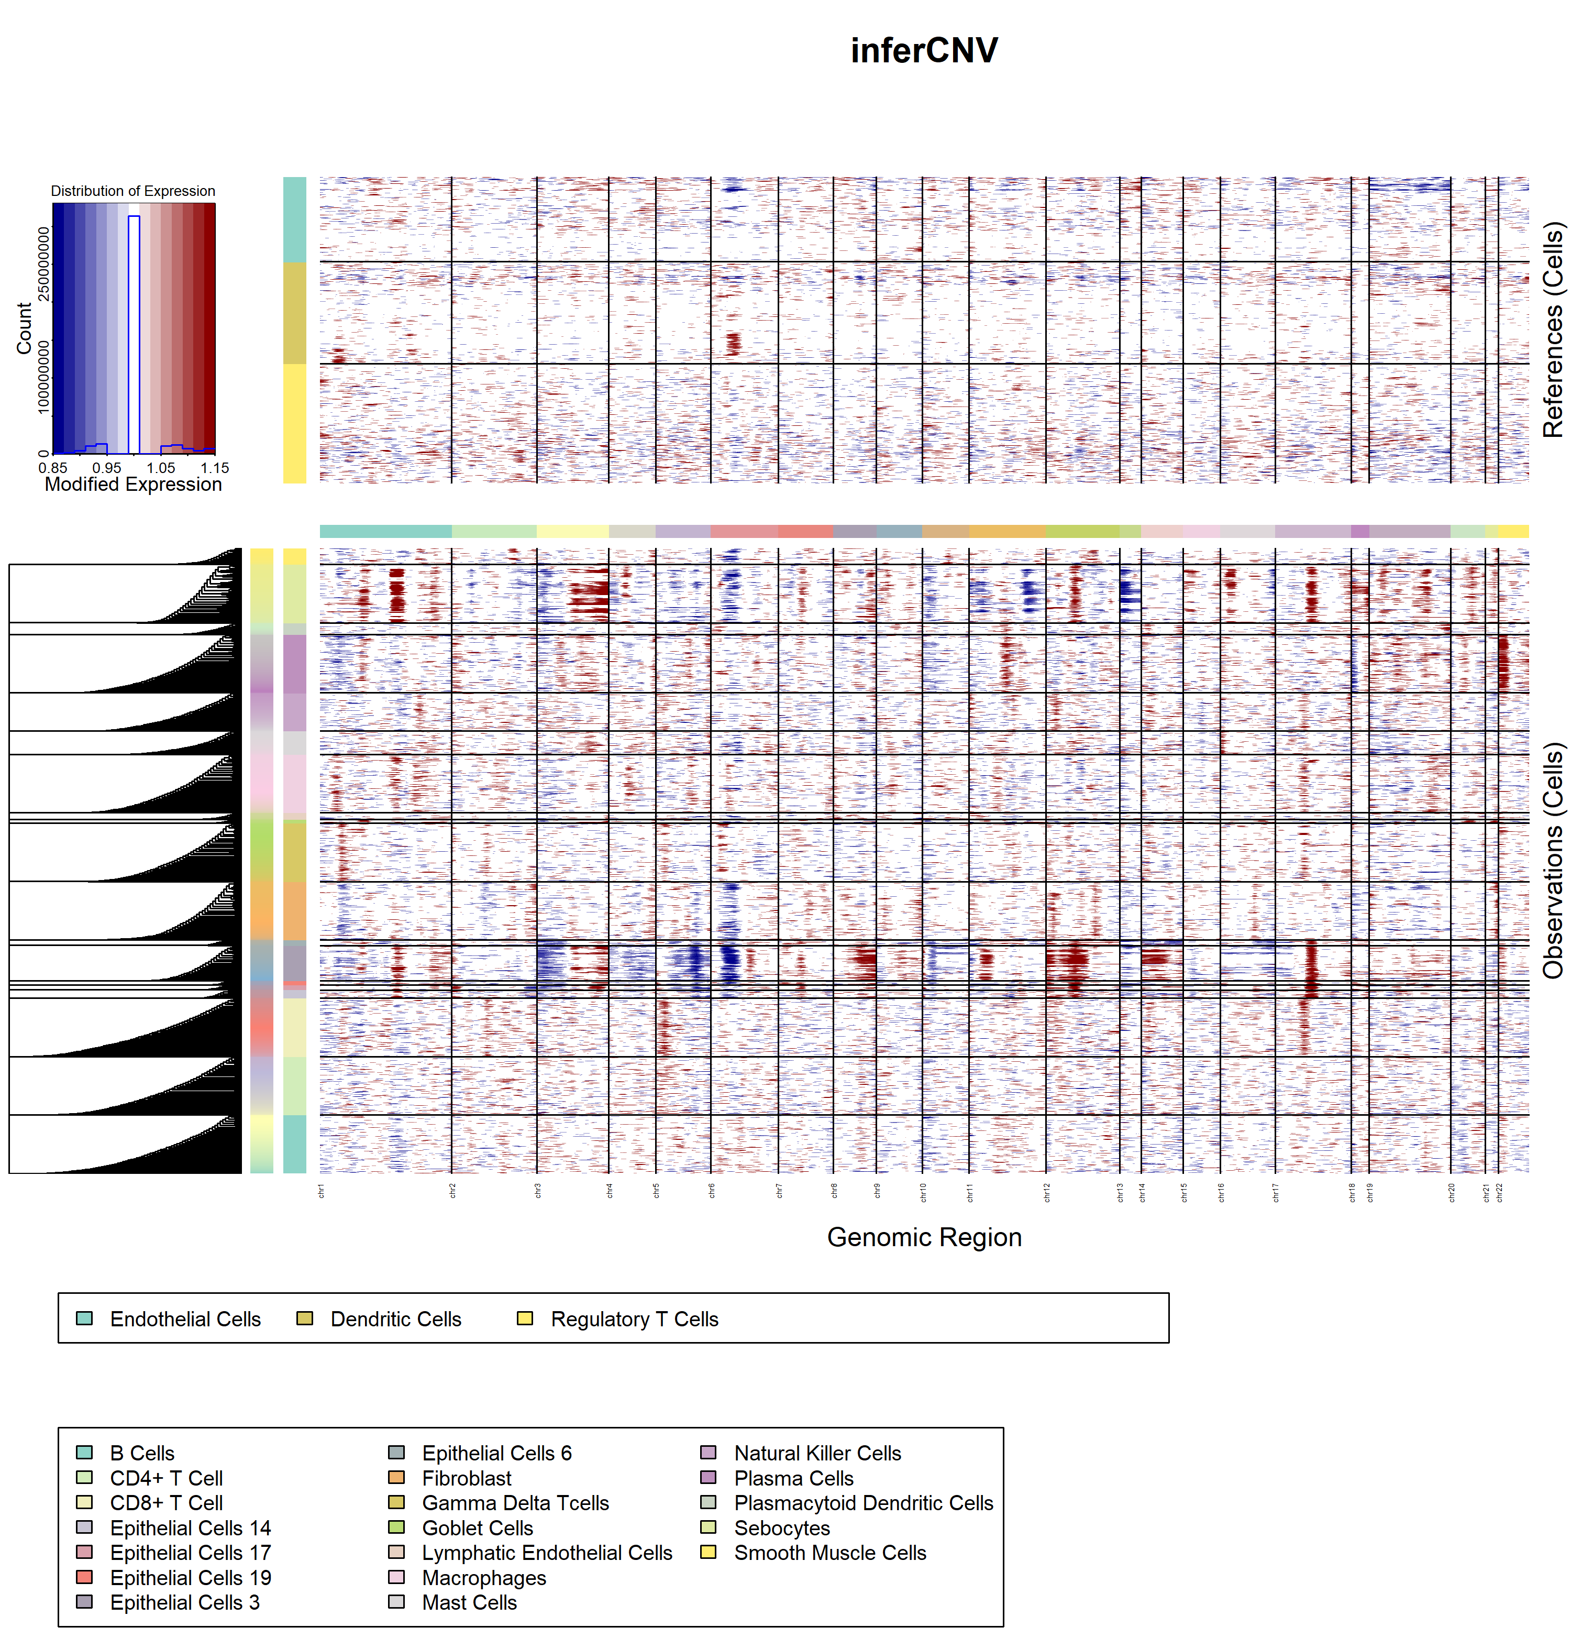

Slide 17
Pathway Activity Analysis (GSVA)
Instead of focusing on single genes, GSVA scores the activity of predefined gene sets (pathways) in each cell or cluster.
Transforms the gene expression matrix into a pathway activity matrix, enabling direct comparison of biological processes across conditions or cell types. Works well with Hallmark (MSigDB), KEGG, Reactome, or custom gene sets.

Slide 18
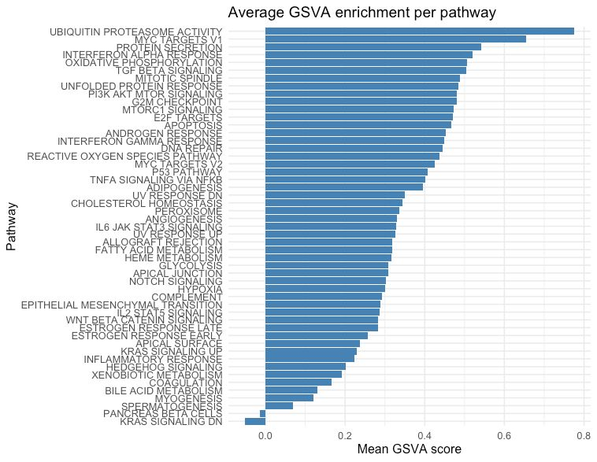

Slide 19
Correlating GSVA Pathways

Slide 20
THANK YOU

